Slide 1


Home credit defaulter prediction
Team –
Kamala Nayana Uppalapati
Soumya zacharia
Vignesh bageerathan

Slide 2
Problem Statement
Many people struggle to get loans due to insufficient or non-existent credit histories. And, unfortunately, this population is often taken advantage of by untrustworthy lenders.
Home Credit strives to broaden financial inclusion for the unbanked population by providing a positive and safe borrowing experience. In order to make sure this underserved population has a positive loan experience, they have to ensure clients that are capable of repayment are not rejected and that loans are given with a principal, maturity, and repayment calendar that will empower their clients to be successful.
Predicting whether or not a client will repay a loan or have difficulty is a critical business need.

Slide 3
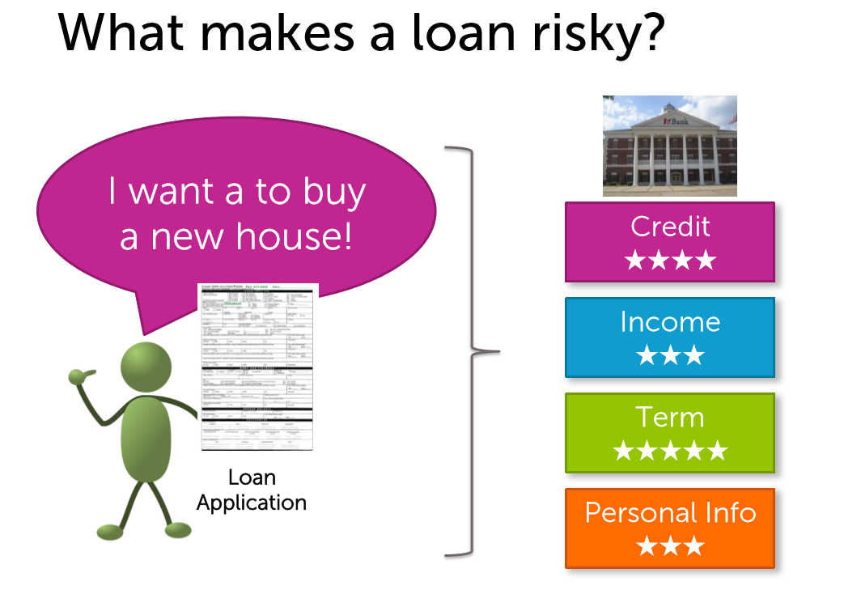

Slide 4



Work flow
Data Input
Exploratory Data Analysis
Missing Data Observations
Feature Importance
Handling Missing Data
MLE & MCMC
Modelling
Prediction
TARGET = 0
SAFE
RISKY
TARGET = 1

Slide 5
Data description
Size - https://www.kaggle.com/c/home-credit-default-risk/data -3GB
The data is provided by Home Credit, a service dedicated to provided lines of credit (loans) to the unbanked population.
1. application_train/application_test: the main training and testing data with information about each loan application at Home Credit. Every loan has its own row and is identified by the feature SK_ID_CURR.
2. bureau: data concerning client's previous credits from other financial institutions. Each previous credit has its own row in bureau, but one loan in the application data can have multiple previous credits.
3. bureau_balance: monthly data about the previous credits in bureau. 4. previous_application: previous applications for loans at Home Credit of clients who have loans in the application data. Each current loan in the application data can have multiple previous loans.
5. POS_CASH_BALANCE: monthly data about previous point of sale or cash loans clients have had with Home Credit. Each row is one month of a previous point of sale or cash loan, and a single previous loan can have many rows.
6. credit_card_balance: monthly data about previous credit cards clients have had with Home Credit. Each row is one month of a credit card balance, and a single credit card can have many rows.

Slide 6
Packages Used
Numpy
Pandas
matplotlib
Seaborn
Sklearn
Scipy
Lightgbm
Xgboost
Pymc3

Slide 7
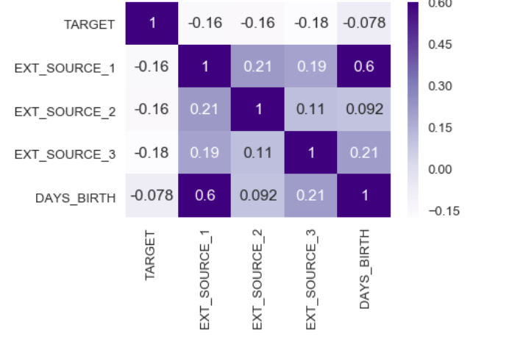
Exploratory Data Analysis
Finding the positvely and negatively correlated columns with the target Found + and – correlations with the TARGET column
Sorted the correlation values
Correlation – Implemented Pearson correlation
Pearson correlation coefficient is a measure of the linear correlation between two variables X and Y. It has a value between +1 and −1, where 1 is total positive linear correlation, 0 is no linear correlation, and −1 is total negative linear correlation
Plotted the KDE to find the variation in the target value with the features

Slide 8

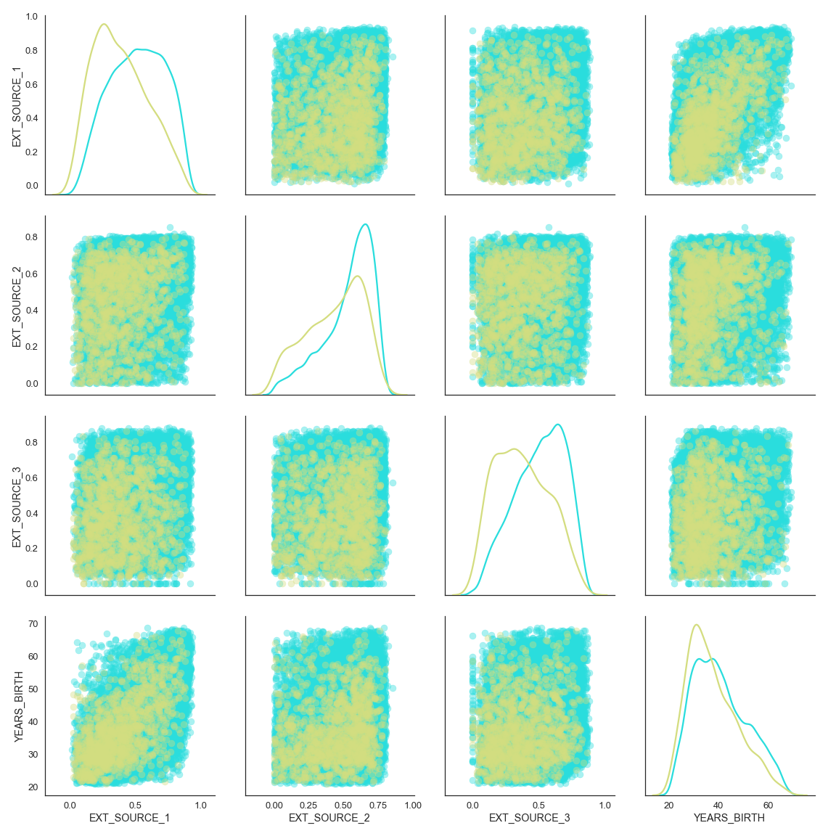
Age and Source feature pair plot

Slide 9
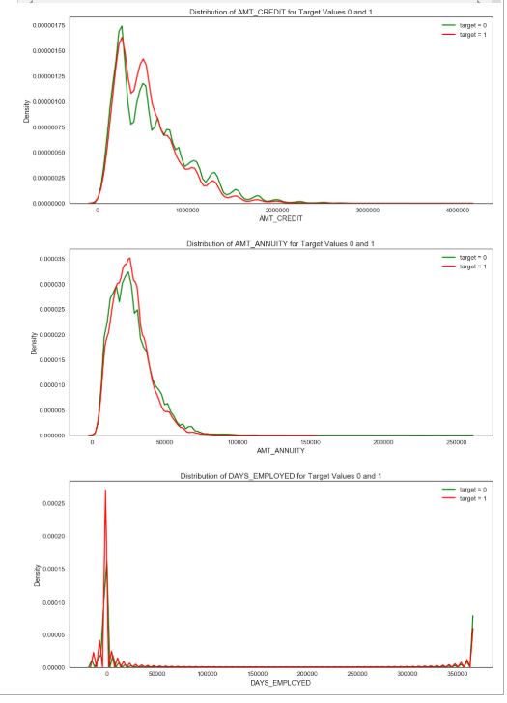
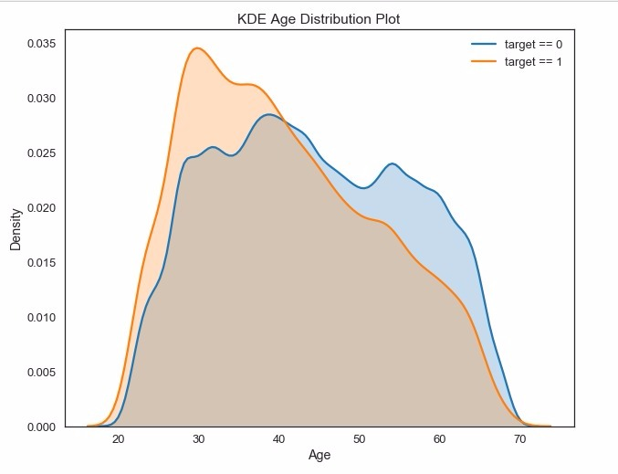
Highly correlated
Less correlated

Slide 10
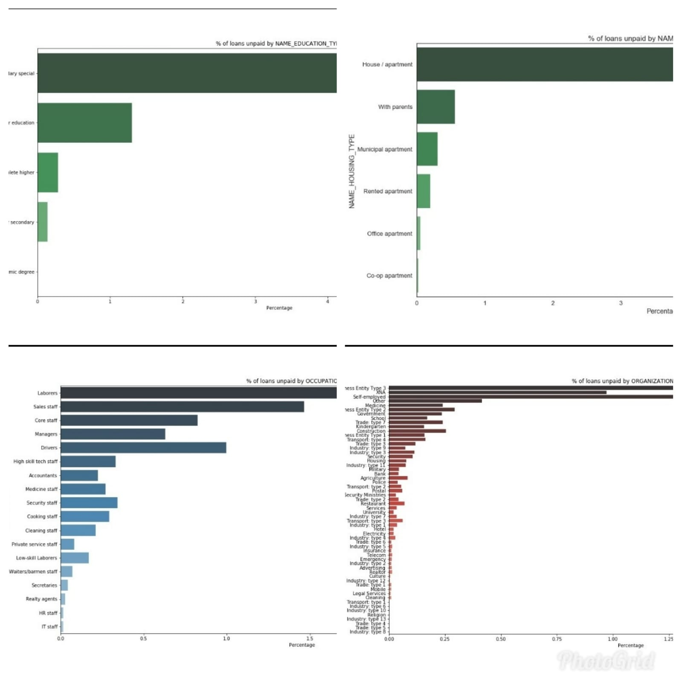
Exploratory Data Analysis
Laborers are by far the biggest users of loans, and also have the greatest variance in incomes. It can also be observed that laborers have the highest percentage of loan defaulters , followed by Sales staff and core staff
People with education type Secondary/secondary special are highly unlikely to repay the loan

Slide 11
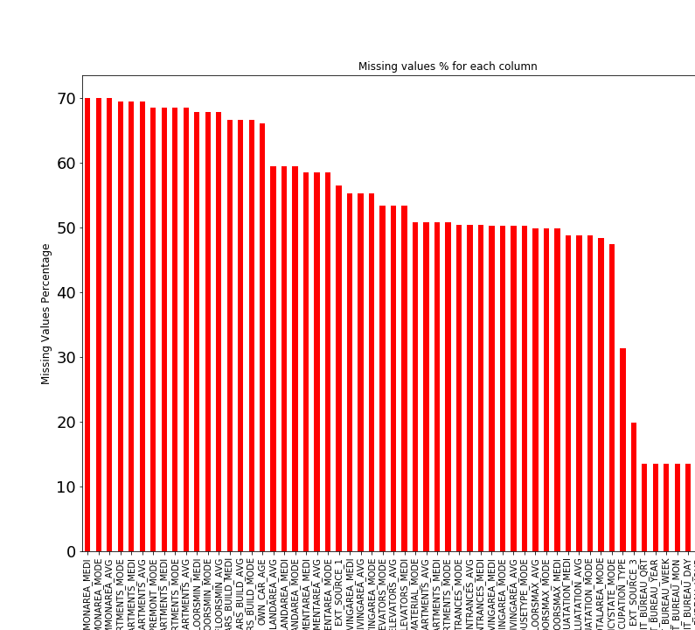
Missing value observation
Missing values - We created a table with missing values and respective percentages. Sort the table by percentage of missing descending and calculated missing value statistics.

Slide 12
Handling Missing Data
We inserted mean value of the dataset for the missing float values in the columns and mode value of the dataset for the object values in the columns. Missing Data was replaced by mean value for numerical columns and mode value for categorical columns
There are lots of NaN values in the dataset .This should be handled inorder to extract features for predicting the Target. We can fill the missing values with mean or mode, or eliminate the columns that have very high percentage of missing values

Slide 13
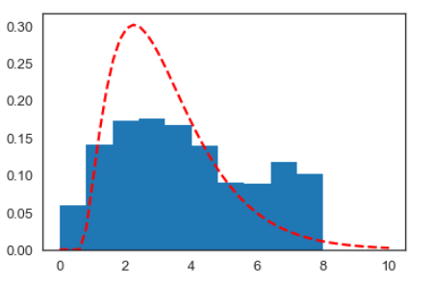
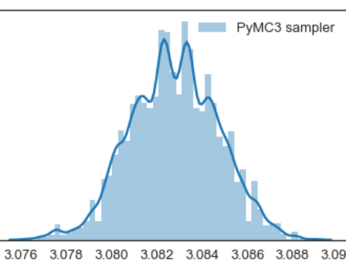
MLE and MCMC
MLE and MCMC are applied to the day credit column to find the number of days borrower will take to close the loan
Used mcmc to observe the posterior distribution

Slide 14
Feature engineering
CLASSIFIERS | Featured Data – Accuracy Score % | Cleaned Data – Accuracy Scores %
KNN | 91.345 | 91.30
RANDOM FOREST | 91.881 | 91.824
LOGISITIC REGRESSION | 92.003 | 91.945
GAUSSIAN NAIVES BAYES | 92.0013 | 91.947
LGBM | 92.01 | 91.9769
XG BOOST | 92.02 | 91.95
Encoded the categorical variables
The data set appli_train has 122 columns. So it is necessary to find out the highest correlated columns to make the best predictions
XGBoost is an implementation of gradient boosted decision trees designed for speed and performance that is dominative competitive machine learning

Slide 15
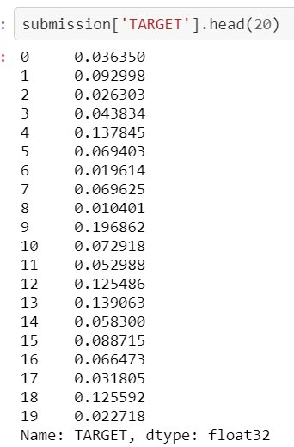
Modelling
Used XGB Classifier and modelled train data
Applied this classifier to predict the TARGET Values of test data
The result of the predictor from 0 to 1 indicates probability that the loan will be repaid
Considering the trend in train data we have chosen a threshold value and categorized the target values to 0 and 1
Concatenated the target column to the test dataset

Slide 16
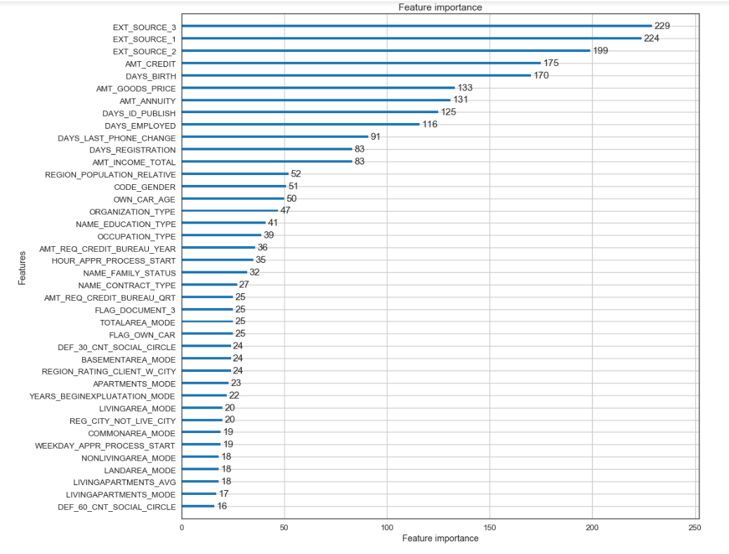
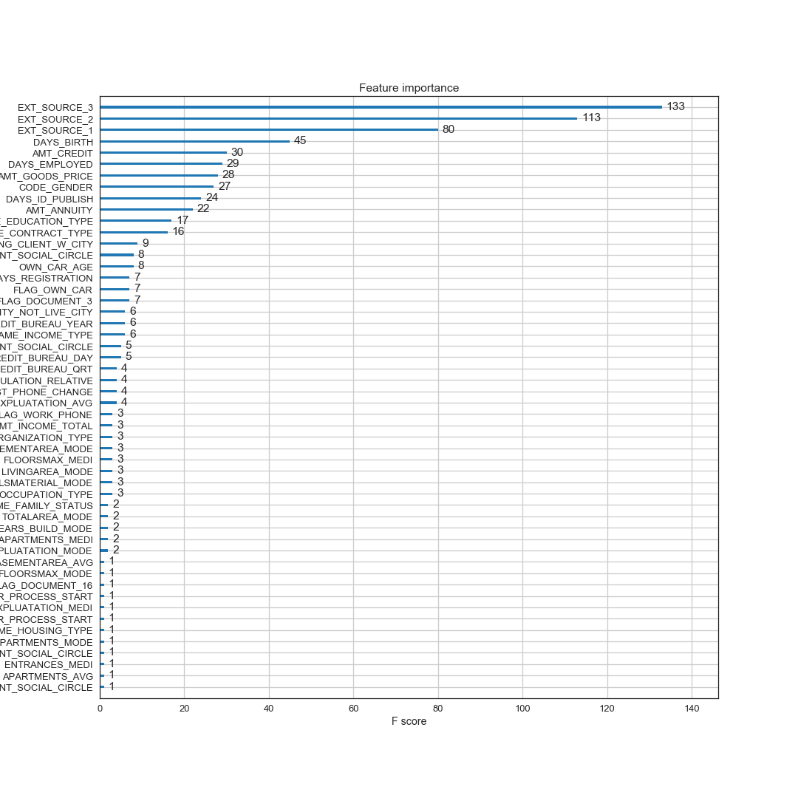
Feature Importance using LIGHT GBM and XGBoost
Light GBM
XGboost

Slide 17
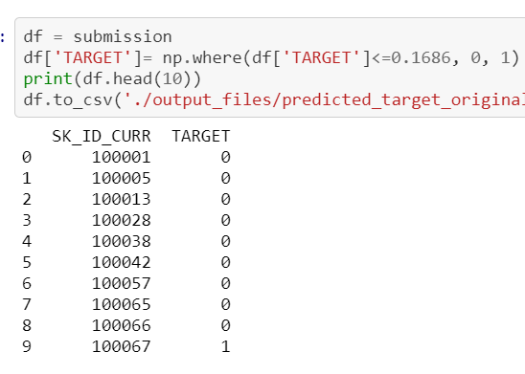
Prediction
Used predict_proba method to predict the target values based on train data values
Considering the trend in train data we have chosen a threshold value and categorized the target values to 0 and 1
Concatenated the target column to the test dataset

Slide 18
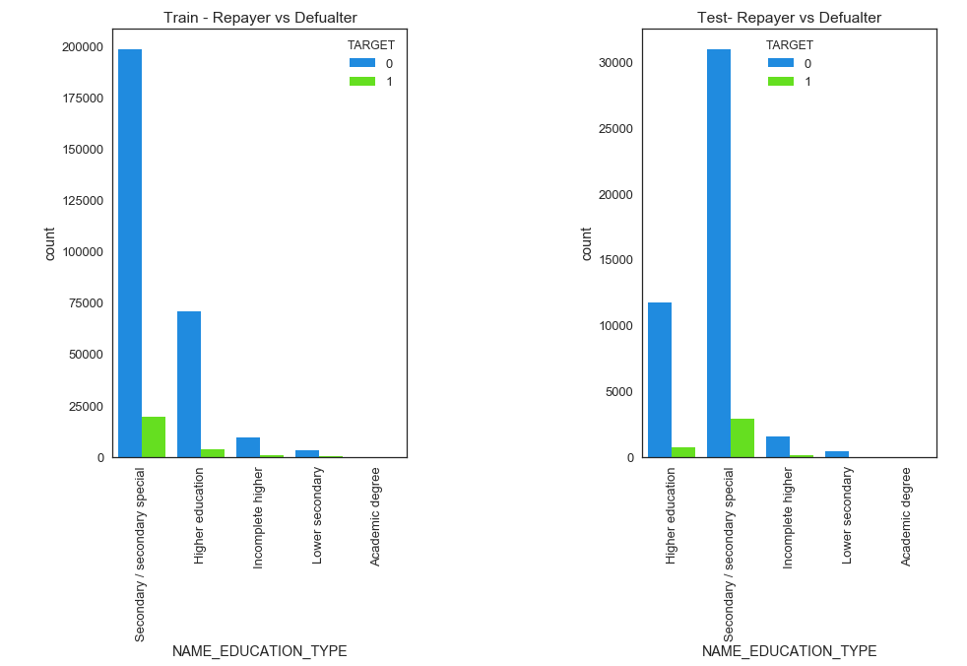
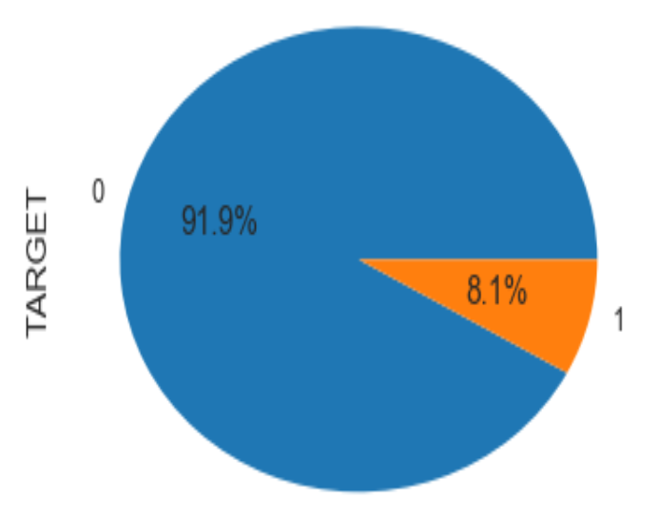
Prediction analysis

Slide 19
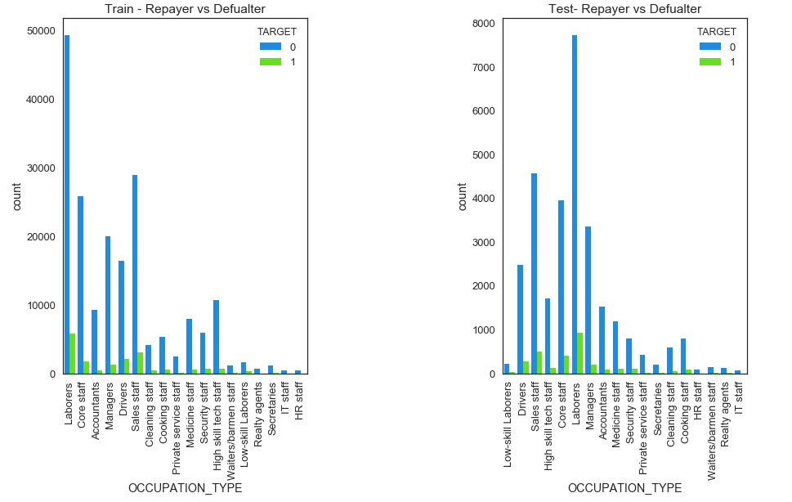
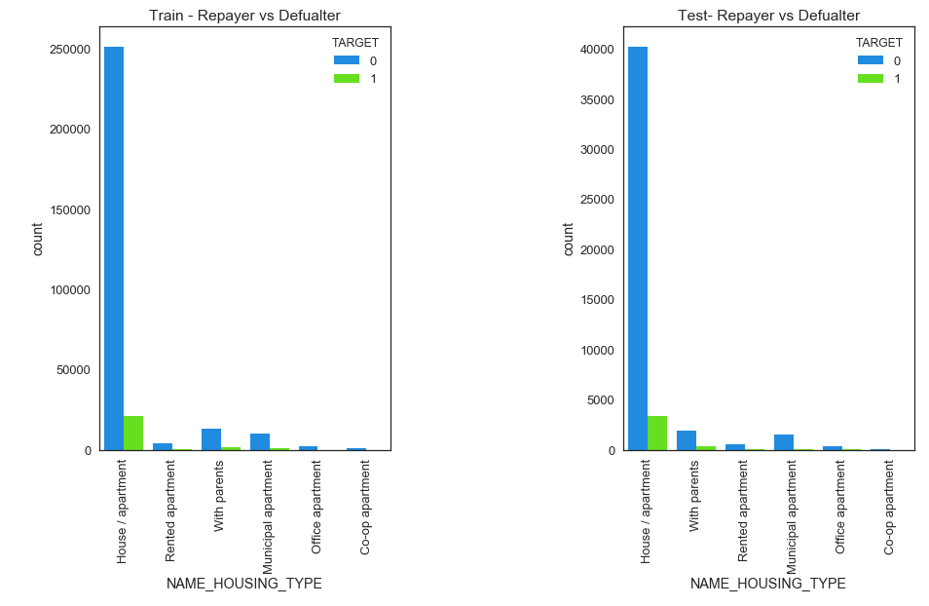
Prediction analysis

Slide 20
Results
Used 6 different classifiers and compared their prediction scores
Improved the prediction accuracy up to 92.021 % by applying feature importance on test data
Modelled the training data using XGBoost classifier and predicted target values on test data
Predicting the probability that each client (borrower) in the test data repays the loan
Obtained satisfactory results when compared the test results with train data

Slide 21
Thank you

